Slide 1
LEVERAGING CLOUD AND APIS as a platform for innovation
Mikael Puittinen, Chief Technology Officer

Slide 2
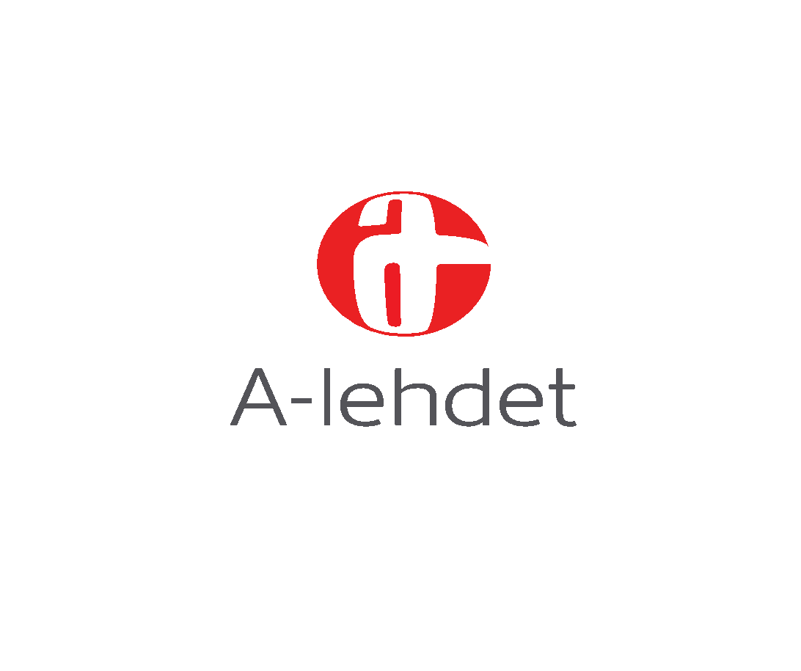










SC5 BRIEFLY
Introducing
CLOUD SOLUTIONS
BUSINESS APPLICATIONS
DIGITAL
DESIGN
10
YRS
60+ CUSTOMERS
200+ PROJECTS
65
HACKERS
DESIGNERS
HEL
JKL
6
MEUR

Slide 3
DIGITALIZATION CHALLENGES

Slide 4
Digitalization is A great opportunity AIM HIGH TO FULLY LEVERAGE IT
Digitalization challenge: Unknown territory
Cost cuts are too often seen as the main advantage of digitalization.
The true winners of digitalization are companies that leverage the digital opportunity to generate new business with new services and / or customers.
NEW
BUSINESS
COST
CUTS

Slide 5

Digitalization is A great opportunity AND IT REQUIRES NEW WAYS OF THINKING
Digitalization challenge: Unknown territory
Majority of companies going digital are from traditional business.
IT know-how is focused on operations of internal business applications.

Slide 6
IT RESOURCES ARE NOT FOCUSED ON CUSTOMER VALUE
Digitalization challenge: Misplaced investments
Traditionally most of the investments on digital services has gone to things end-customers don’t see or care about.
Procurement of / Development on traditional IT infrastructure is slow, i.e. in addition to funds, it also consumes time.
USER INTERFACE
€
20%
APPLICATION LOGIC
FAULT TOLERANCE
SCALABILITY
IDENTITY MGMT
MIDDLEWARE
DATABASES
€€€
STORAGE
80%
NETWORKING
OPERATING SYSTEM
HARDWARE
VIRTUALIZATION

Slide 7
LEGACY IT CANNOT RESPOND TO THE INNOVATION PACE REQUIRED BY CUSTOMERS
Digitalization challenge: Slow cycles for legacy IT
Customer facing applications need to consume and produce data that is managed by your in house business applications.
However, development cycles for internal business applications is typically multiple months, which is too slow for end-customer facing service development.
days
EXTERNAL
APPLICATIONS
INTERNAL APPLICATIONS
months

Slide 8
NEW WAYS TO INTERACT WITH SERVICES ARE EMERGING
Digitalization challenge: New user interfaces
In addition of traditional (web) user interfaces, new ways of interacting with services are emerging (devices, wearables, bots, integrations with other services, …).
Solutions that are tightly coupled with their web user interface are difficult to adapt to alternative user experiences.
3rd PARTY APP

Slide 9
HOW TO TACKLE THE DIGITALIZATION CHALLENGE

Slide 10
get the most of your digitalization investments WITH SERVERLESS CLOUD
Digitalization challenge: Misplaced investments
Serverless cloud computing services from cloud vendors increase productivity by allowing developers to focus on services instead of servers.
Serverless infrastructure scales automatically and is billed only per use. Infrastructure costs are only a fraction of traditional provisioned (IaaS) cloud infrastructure.
USER INTERFACE
€€€
80%
APPLICATION LOGIC
MANAGED CLOUD SERVICES
(Serverless compute, databases, API Management, storage, Identity management, …)
Availble as self-service for developers
€
20%

Slide 11
CASE: PERISCOPE
Digitalization challenge: Misplaced investments
Periscope leverages serverless components from AWS to provide a zero maintenance, cost-effective, scalable and durable backend.

Slide 12
ENABLE INNOVATION ON LEGACY SYSTEMS WITH APIS
Digitalization challenge: Slow cycles for legacy IT
Introducing an agile API on top of legacy IT systems improves developer experience and time-to-value.
APIs ensure that the new digital business is connected to your internal business processes.
USER INTERFACE
days
API / BACKEND
LEGACY IT SYSTEMS
months

Slide 13
MICROSERVICES enable FLEXIBILITY IN DEVELOPMENT AND DEPLOYMENT
Digitalization challenge: Slow cycles for legacy IT
DEV TEAM 1
DEV TEAM 2
DEV TEAM 3
DEV TEAM 4
Products
API
Customers API
Users
API
Custom
API
…
CRM
IAM
Custom
…
Corporate applications managed by IT
Notes:
Splitting API to microservices allow independent development, deployment and operations accross teams
Pick the right technology for each service
Empower teams to work independently
APIs / services matter, not the storage location (vs. MDM)
Connect legacy IT

Slide 14
CASE: INDUSTRYHACK
Digitalization challenge: Slow cycles for legacy IT
For IndustryHacks at Veho and Gasum, SC5 created cloud APIs that provided participant hackers with easy and documented access to data managed in internal IT applications.
This allowed developers to focus on innovation rather than data access setup.

Slide 15
BE PREPARED FOR FUTURE BUSINESS CONCEPTS AND INTERACTIONS WITH APIs
Digitalization challenge: New user interfaces
Use APIs to decouple the application logic from the user experience.
This allows to build new user experiences and device / systems integrations without expensive rework.
3rd PARTY APP
API / BACKEND

Slide 16
LEVERAGE A CULTURE OF EXPERIMENTATION TO FIND DIGITALIZATION OPPORTUNITIES.
Digitalization challenge: Unknown territory
Cheaper and faster development allows to run more experiments on cloud APIs on digital business concept ideas.
More experiments increase the probability of hitting digital goldmines.
IDEAS
DIGITAL SUCCESS
PROTOTYPES
PILOTS

Slide 17
LEVERAGE ”MODE 2” IT MODEL TO BECOME A DITIGAL BUSINESS SPRINTER
Digitalization challenge: Misplaced investments

Slide 18
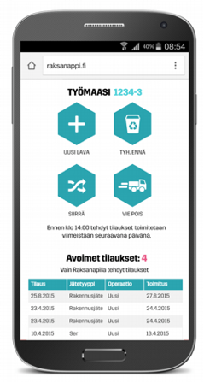
CASE: LASSILA & TIKANOJA RAKSANAPPI
Digitalization challenge: Unknown territory
L&T formed a new ”Digital business” team to ramp-up their digital service offering.
Raksanappi was designed, validated and designed using the 5-day design sprint methodology (developed by Google).

Slide 19
”TO MAKE 4 GAMES,
WE KILLED 14”
(Source: video at http://supercell.com/en/our-story/)

Slide 20
THANK YOU!
Mikael.puittinen@sc5.io
@mpuittinen

